Slide 1

How to make a pollution free city-green and beautiful city

Slide 2


What is pollution
Hello friends, today we will talk about a topic that how to make a pollution free city-green and beautiful city so first we will talk about pollution . pollution means the presences of harmful or poisonous substance in the environment pollution can be spread from the smoke of cars , truck , factory etc garbage lying on the land or water can also be a garbage

Slide 3

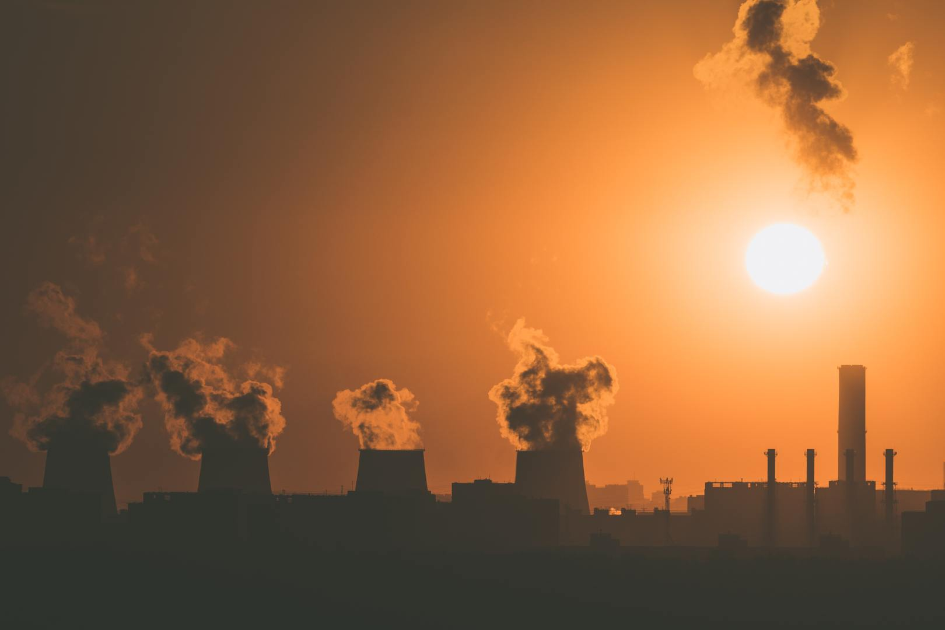
Pollution

Slide 4

HOW TO MAKE A POLLUTION FREE CITY
Use Non-petroleum liquid instead of using petroleum liquid
Avoid using automobile at short distances
Turn the automobile engine of whenever there is red light at signal pole
Do car pool whenever possible

Slide 5

Green and beautiful city
As you know that green areas are the best example of beauty . the city contain the good quantity of green areas can be more beautiful , sculpture like small fountain , river , lake , waterfall can be also a part of beauty so the thing is that if there are more green areas , nice sculptures so that place or city will be more attractive

Slide 6

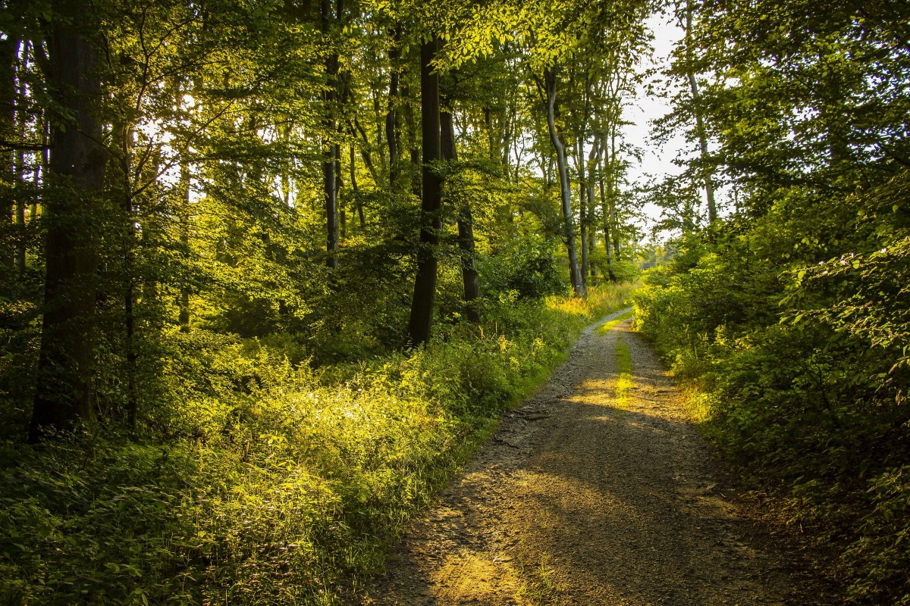
Pictures of nature

Slide 7
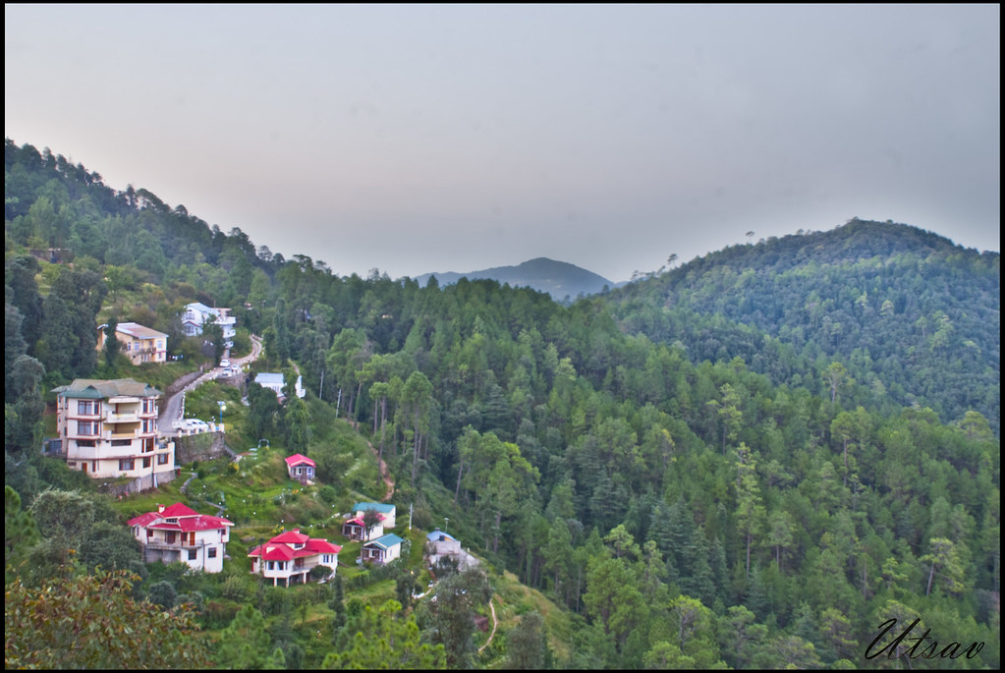
Some green city

Slide 8


shimla
As you can see in the picture above this is the picture of a city Shimla located in the city of India this is the pollution free green city because its total population in the year in the year 2021 was 204,000 very less productivity is there in that city and a large amount of greenery so it seems beautiful There are historical temples , beautiful trekks and you can also explore the hills of queen

Slide 9
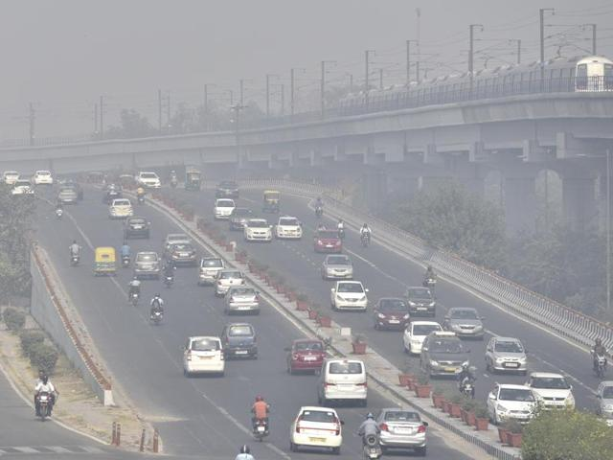
DELHI

Slide 10

Delhi
In the above one picture you can see that there is pollution everywhere and according to a WHO survey of 1,650 world cities , Delhi is the worst in any other major city in the world , the air quality of Delhi is improved by 15 percent but it is still in the top 10, Despite an 11 percent reduction in the annual average of PM2.5 levels due to the COVID-19 lockdown curbs imposed last year, India emerged as the world’s third most polluted country after Bangladesh and Pakistan.

Slide 11
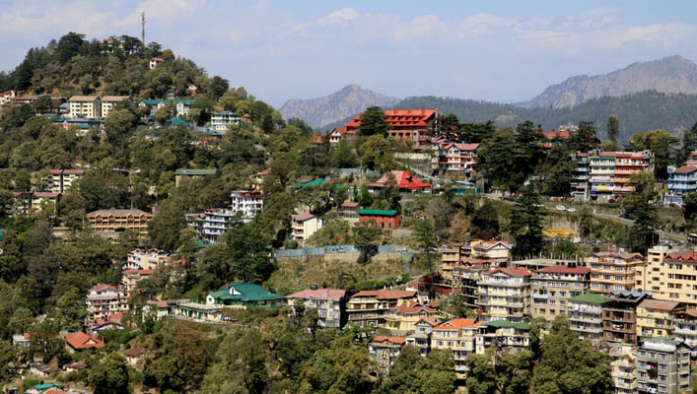
The comparison of both shimla and delhi
Green areas of shimla
Air pollution of delhi

Slide 12
How to reduce pollution
The government of delhi has taken some strict orders to reduce pollution like they have launch the new electric public buses , metro station and many more to reduce pollution made by public transport and they have declare to make more gardens to reduce the amount of pollution

Slide 13


